Slide 1
Probability & Statistics
Rijah Khan
Cyber Security

Slide 2
Chapter 3
Measures of Central Tendency

Slide 3
Measures of Central Tendency
A measure of central tendency is a descriptive statistics that describes the average.
By identifying the “Average" central tendency allows researchers to summarize a large set of data into a single value.
The five most commonly used measures of central tendency are:
Arithmetic Mean
Geometric Mean
Harmonic Mean
Median
Mode

Slide 4
Arithmetic Mean
The most commonly used and familiar index of central tendency for a set of raw data or a distribution is the arithmetic mean.
The arithmetic mean of a set of values is their sum divided by their number.
The formula for calculating the arithmetic mean is:
Mean = (Sum of all values) / (Number of values)
Add up all the values in the dataset.
Count how many values are in the dataset.
Divide the sum obtained in step 1 by the count obtained in step 2.

Slide 5
Arithmetic Mean-Population
The mean of a Population is
∑ x – is the sum of all values of X in the population.
N – is the number of values in the entire population.
The Greek letter mu, μ – Represents a Population Mean

Slide 6
Arithmetic Mean-Sample
The mean of a sample is
∑ x – is the sum of all values of X in the sample.
n – is the number of values in the sample.
read as “ x-bar – Represents a Sample Mean

Slide 7
Arithmetic Mean for Ungrouped Data
The Statistics exam had the following results.
71, 82, 55, 76, 66, 71, 90, 84, 90, 64, 71, 70, 83, 45, 73, 51 68

Slide 8
Arithmetic Mean for Grouped Data
If X are the class marks and f are the corresponding frequencies
– sum of the interval midpoints times the number of data in the interval.
– sum of all the frequencies.

Slide 9
Example 1
The following table represents the number of hours per day of watching TV in a sample of 500 people.
Number of hours | 0-1 | 2-3 | 4-5 | 6-7 | 8-9 | 10-11 | 12-13
Frequency | 64 | 92 | 141 | 86 | 71 | 35 | 11
What is the mean number of TV viewing hours in this group?
What length of time is most often spent in front of a TV by this group?
What is the median number of TV viewing hours?

Slide 10
Interval | Midpoint (x_{i}) | Frequency f_{i} | Cumulative Frequency | f_{i}x_{i}
0 - 1 | 0.5 | 64 | 64 | 64 x 0.5 = 32.0
2 - 3 | 2.5 | 92 | 156 | 92 x 2.5 = 230.0
4 - 5 | 4.5 | 141 | 297 | 141 x 4.5 = 634.5
6 -7 | 6.5 | 86 | 383 | 86 x 6.5 = 559.0
8 - 9 | 8.5 | 71 | 454 | 71 x 8.5 = 603.5
10 - 11 | 10.5 | 35 | 489 | 35 x 10.5 = 367.5
12 - 13 | 12.5 | 11 | 500 | 11 x 12.5 = 137.5
Find the midpoints and cumulative frequencies for the intervals
Calculate the midpoints times frequency for each interval
Determine the sum of frequency and f_{i}x_{i}

Slide 11
The mean number of viewing hours for this group was approximately five hours.

Slide 12
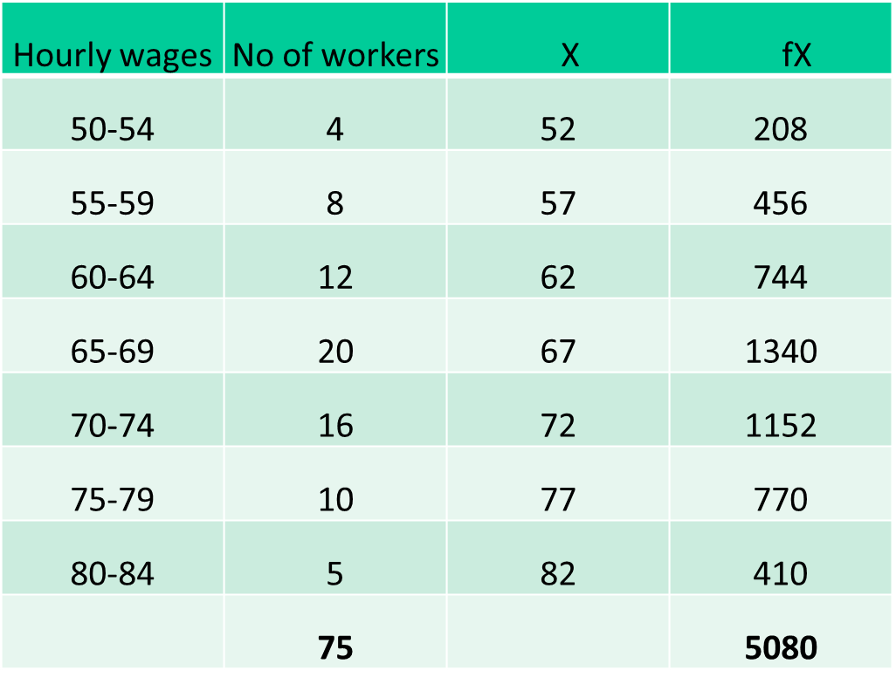
Example 2

Slide 13
Merits and Demerits of Arithmetic Mean
Merits of Arithmetic Mean:
Easy Understanding
Uses All Data
Statistical Properties
Balances Deviations
Preserves Information
Demerits of Arithmetic Mean:
Sensitive to Outliers
Not Robust
May Not Be a Data Point
Not for Categorical Data
Loss of Information

Slide 14
Weighted Arithmetic Mean
The Weighted Arithmetic Mean is a statistical measure that incorporates different weights assigned to each value in a dataset.
It is calculated by multiplying each value by its respective weight, summing these weighted values, and then dividing by the sum of the weights.
Used where all values are not equal in significance.

Slide 15
– sum of the weighted values.
– sum of the various weighting factors.

Slide 16
Example
The averages (means) of five Cyber classes are 69, 72, 66, 75, and 78. If the class sizes were 26, 33, 25, 35, and 37 respectively, determine the weighted arithmetic mean for the entire grade.
Classes | Mean, x_{i} | Weight Factor Class Size, w_{i}
1 | 69 | 26
2 | 72 | 33
3 | 66 | 25
4 | 75 | 35
5 | 78 | 37

Slide 17
The average for the entire grade is 72.6%

Slide 18
Median
The median is the middle value in an ordered list.
It is the value in the middle; half of the values are larger than the median and half of the values are smaller than the median.
The median is simply another name for the 50th percentile.

Slide 19
Median for Ungrouped Data
If n is odd, the median is the middle number
What is the median of the following scores: 10 8 14 15 7 3 3 8 12 10 9
Sort the scores: 15 14 12 10 10 9 8 8 7 3 3
Determine the middle score: middle = (n + 1) / 2th = (11 + 1) / 2th= 6th
Middle score = median = 9

Slide 20
Median for Ungrouped Data
If n is even, the median is the average of the 2
middle numbers
What is the median of the following scores: 24 18 19 42 16 12
Sort the scores: 42 24 19 18 16 12
Determine the middle score: middle = (N + 1) / 2th = (6 + 1) / 2th = 3.5th
Median = average of 3rd and 4th scores: (19 + 18) / 2 = 18.5

Slide 21
Example
The Statistics exam had the following results.
71, 82, 55, 76, 66, 71, 90, 84, 90, 64, 71, 70, 83, 45, 73, 51 68
Order the data:
45, 51, 55, 64, 66, 68, 70, 71, 71,
71, 73, 76, 82, 83, 84, 90, 90,
Therefore the median is 71.

Slide 22
Median for Grouped Data
L is the lower boundary of the median class.
n is the total number of data points.
C is the cumulative frequency of the class before the median class.
h is the width or size of the class interval.
f is the frequency of the median class.

Slide 23
Example
c) What is the median number of TV viewing hours?
The median is the middle value. The median is the average of the 250th. By referring to the cumulative frequency column we notice that the 250th data occur in the interval 4-5.
We would then estimate the median to be 4.5 hours of viewing time.

Slide 24
Example
Class Intervals | Frequency | Cumulative Frequency
120 _ 129 | 4 | 4
130 – 139 | 7 | 11
140 – 149 | 18 | 29
150 – 159 | 11 | 40
160 – 169 | 6 | 46
170 – 179 | 5 | 51
← Median class
Here, n= 51.
Therefore, n/2 = 51/2 = 25.5
The observations lie between the class interval 145-150, which is called the median class.

Slide 25
Merits and Demerits of Median
Merits of Median:
Resilience to Outliers
Suitable for Skewed Data
Preserves Data Order
Use in Ordinal Data
Demerits of Median:
Loss of Precision
Complex for Grouped Data
Not Suitable for Continuous Data
Doesn't Utilize All Data

Slide 26
Measures of Position
A measure of position is a statistical term used to identify the relative position or ranking of a specific data point within a dataset.
Common Measures of Position:
Quartiles
Deciles
Percentiles

Slide 27
Quartiles
Quartiles divide a dataset into four equal parts with each part containing 25% of the data.
Q1 (First Quartile): Marks the 25th percentile, separating the lowest 25% of data from the rest.
Q2 (Second Quartile): Represents the median, dividing the data into two equal halves (50% below and 50% above).
Q3 (Third Quartile): Identifies the 75th percentile, splitting the upper 25% of data from the lower 75%.
25%
25%
25%
25%
Q₁
Q₂
Q₃

Slide 28
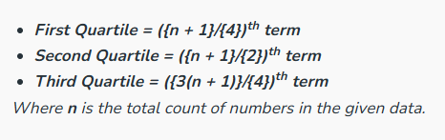
Quartiles for Ungrouped Data

Slide 29
Example
Weight of patients:
175, 260, 150, 165, 170, 180, 190, 210, 210, 235, 240, 270
Step 1: Rank data and divide into 4 parts:
150, 165, 170 175, 180, 190 210, 210, 235 240, 260, 270
Step 2:
Q1
Q2
Q3
= (170+175)/2
= 172.5
= (190 +210)/2
= 200.0
= (235 + 240)/2
= 237.5

Slide 30
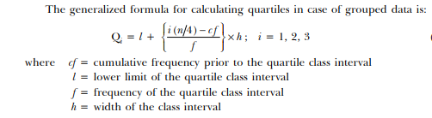
Quartiles for Grouped Data

Slide 31
Deciles
Values which divides the data into ten equal parts are called Deciles and are denoted by D1,D2,....., D9.
D1 (First Decile): Marks the 10th percentile, separating the lowest 10% of data from the rest.
D5 (Fifth Decile): Represents the median, dividing the data into two equal halves (50% below and 50% above).
D9 (Ninth Decile): Identifies the 90th percentile, splitting the upper 90% of data from the lower 10%.

Slide 32
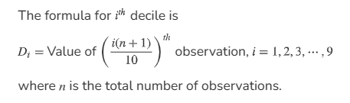
Deciles for Ungrouped Data

Slide 33


Deciles for Grouped Data

Slide 34
Percentiles
Percentiles are the values dividing the data into one hundred parts and are denoted by P1, P2,....., P99.
P10 (10th Percentile): Marks the value below which 10% of the data falls.
P50 (50th Percentile): Represents the median, dividing the data into two equal halves (50% below and 50% above).
P90 (90th Percentile): Identifies the value below which 90% of the data falls.

Slide 35
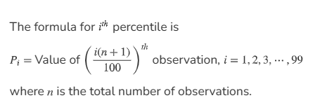
Percentiles for Ungrouped Data

Slide 36

Percentiles for Grouped Data

Slide 37
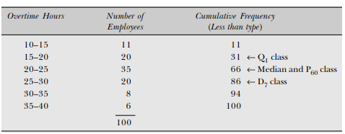
Example
Calculate median, first quartile, seventh decile and sixth percentile.

Slide 38
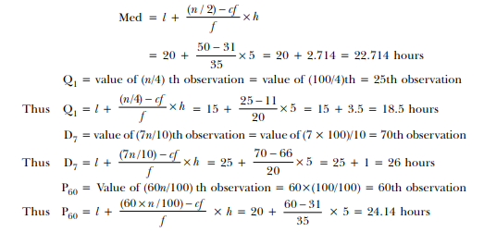

Slide 39
Mode
Unimodal
It helps identify the most common or frequently occurring data point(s).
A dataset can have one mode (unimodal), two modes (bimodal), or more (multimodal).
The mode is especially useful for categorical and discrete data.

Slide 40
Bimodal Distributions
When a distribution has two “modes,” it is called bimodal.

Slide 41
Multimodal Distributions
If a distribution has more than 2 “modes,” it is called multimodal.

Slide 42
Mode for Ungrouped Data
The Statistics exam had the following results.
71, 82, 55, 76, 66, 71, 90, 84, 90,64, 71, 70, 83, 45, 73, 51 68
Therefore the mode is 71.

Slide 43
Mode for Grouped Data
L is the lower class limit of modal class
fm is the maximum frequency
f1 is the preceding frequency of modal class
f2 is the next frequency of modal class
h is the class interval size

Slide 44
Mode for Grouped Data
Hourly wages | No of workers
50-54 | 4
55-59 | 8
60-64 | 12 | f1
65-69 | 20 | fm
70-74 | 16 | f2
75-79 | 10
80-84 | 5
Mode=65+

Slide 45
Example
b) What length of time is most often spent in front of a TV by this group?
The mode is the answer to this question. From the frequency table the model interval is identified by the larges frequency.
The most frequent period of time spent in front of a TV by this group is between four and five hours.

Slide 46
Merits and Demerits of Mode
Merits of Mode:
Simple and Intuitive
Useful for Categorical Data
Identifies Common Values
Resistant to Outliers
Demerits of Mode:
Not Always Unique
May Not Exist
Not Suitable for Continuous Data
Limited Use with Skewed Data

Slide 47
Relations Between the Measures of Central Tendency
In symmetrical distributions, the median and mean are equal
For normal distributions, mean = median = mode
In positively skewed distributions, the mean is greater than the median and mode
In negatively skewed distributions, the mean is smaller than the median & mode
Left-Skewed
Symmetric
Right-Skewed
Mean
Median
Mode
Mean
=
Median
=
Mode
Mode
Median
Mean

Slide 48
Choosing a Measure of Central Tendency
If data contains outliers, use the median
If the data are strongly skewed , use median
If data is roughly symmetrical, the mean and the median will be close, so either is appropriate.
If data is not numeric, use the mode.

